Slide 1
Webex for NetAcad
Updates and Q&A
Kristen Hudson
Technical Manager US / Caribbean
April 2021

Slide 2
Overview & Eligibility

Slide 3

Webex for NetAcad
What: Full feature Webex accounts
Non-transferrable, no session time limit, up to 1000 participants
Why: Continued support of our exceptional NetAcad community and assist with remote instruction needs
Who: Instructors teaching Cisco Career & Training Courses (CCT) that started a class within the last 6 months with at least 3 students enrolled.
CCNA, CCNP Enterprise, CyberOps Associate, DevNet Associate, CCNA Security or Network Security
When: Upon becoming eligible, signup is fully automated through your NetAcad profile

Slide 4
Creating your Webex Account
Email Used: Accounts are provisioned using the email associated with your NetAcad Instructor account.
Existing Webex Users: If you are using a corporate Webex account at your Academy or created a free Webex account using your NetAcad email, you will not be able to request an account.
New Webex Users: Instructors that are eligible for the Enterprise NetAcad Webex accounts and currently do not have an existing Webex account will be able to request an account directly from their profile.

Slide 5
Free Account
1 Host
50 minutes duration
Up to 100 participants
NetAcad Account
Unlimited Co-Hosts
24 hours max duration
Up to 1000 participants
50GB Cloud recording storage
MP4 recordings
Recording transcripts
File transfer feature
Access to Meeting, Events and Training Center

Slide 6
Update for Signing Up

Slide 7
Signup for Webex for NetAcad
The process for provisioning an account is now completely automated!
Before the automated process was in place, there was just a few people provisioning over 9000 accounts in batches manually.
Now, an instructor can control their eligibility and request a license directly through their profile.
NetAcad Support will help with any technical difficulties.

Slide 8
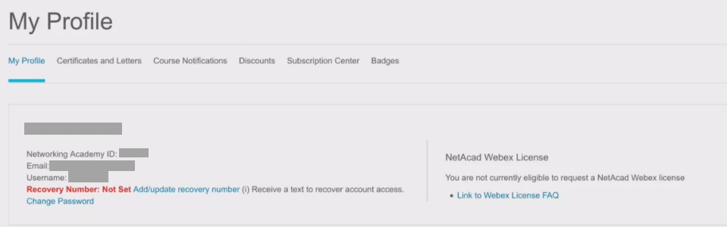
View your current eligibility status - Ineligible
Under “My Profile on netacad.com, there is a section labeled NetAcad Webex License. Here you can view your current eligibility status for a Webex account.
Below is an example of being ineligible.

Slide 9
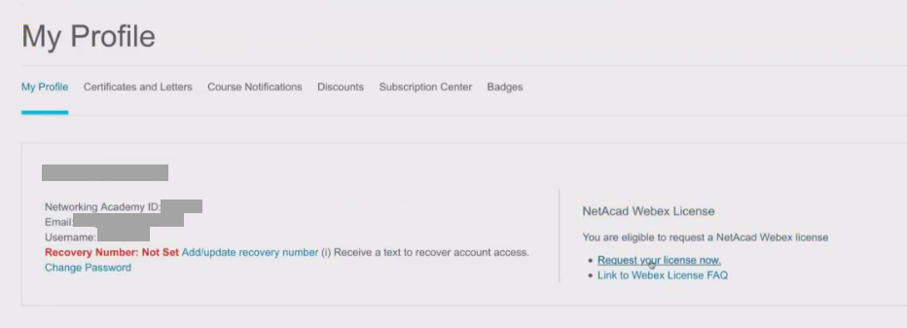
View your current eligibility status - Eligible
Below is an example of being eligible for a Webex account. Once you are eligible, a button will appear that says, “Request your license now”.

Slide 10
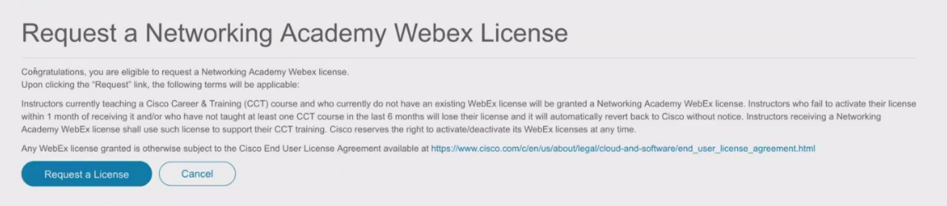
Requesting your Webex License
After clicking “Request your license now”, the next page will have a disclaimer along with a link to the Cisco End User License Agreement. By clicking “Request a License”, you are agreeing to the terms of the agreement.
Your activation link will then be sent to your NetAcad email address. Please be sure to activate your account within 24 hours.

Slide 11
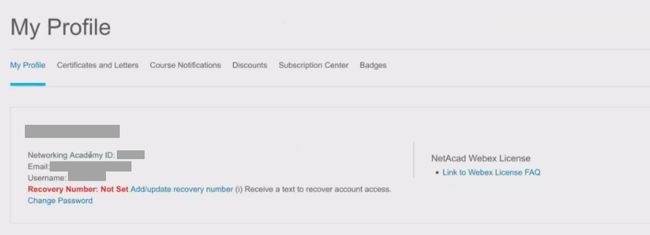
“My profile” view after receiving an account
Once an account has been provisioned, your profile will no longer show an eligibility status or option to request an account. All that will show is a link to the FAQ posted at http://cs.co/webex4netacad

Slide 12
Demo

Slide 13
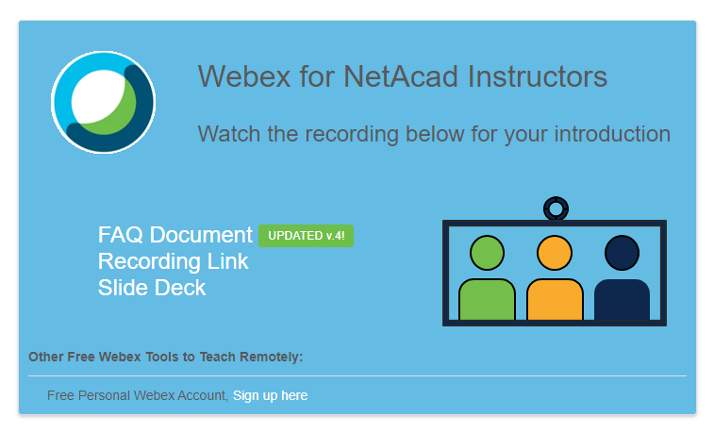
Additional Information
For more information and updates, visit the Instructor Resources for Virtual Learning
http://cs.co/webex4netacad
Updated FAQ
This IPD Session Recording
(Will also be available in the IPD Course)
Slide Deck seen here

Slide 14

1 MILLION
MINUTES!!

Slide 15


Webex 4 NetAcad Statistics
16K Total Meetings
1.36M Total Minutes
Meeting Mins. per Month
March – 497.66K
February – 257.78K
January – 149.62K
December – 75.36K
Equivalent 2-Year Long Webex
4082 Verified Users
3.8K Recorded Minutes
312K
Participants
Top 3 Participant Locations
India
Indonesia
Turkey

Slide 16

Starting Now! Join the Women Rock-IT Event Link in Chat

Slide 17
Questions?

